Slide 1
Create an AWS Account

Slide 2
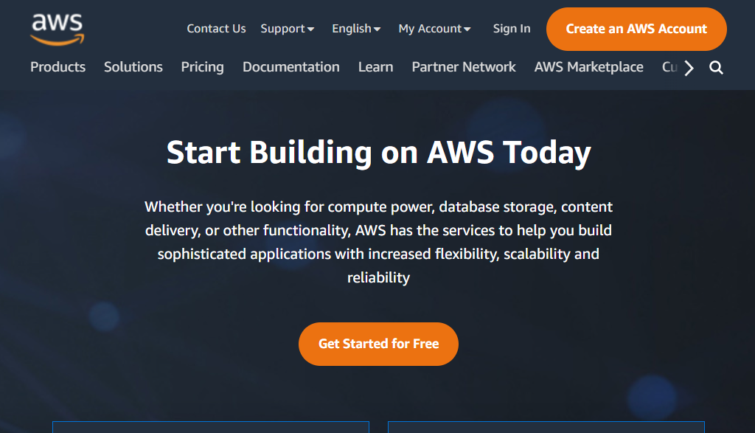
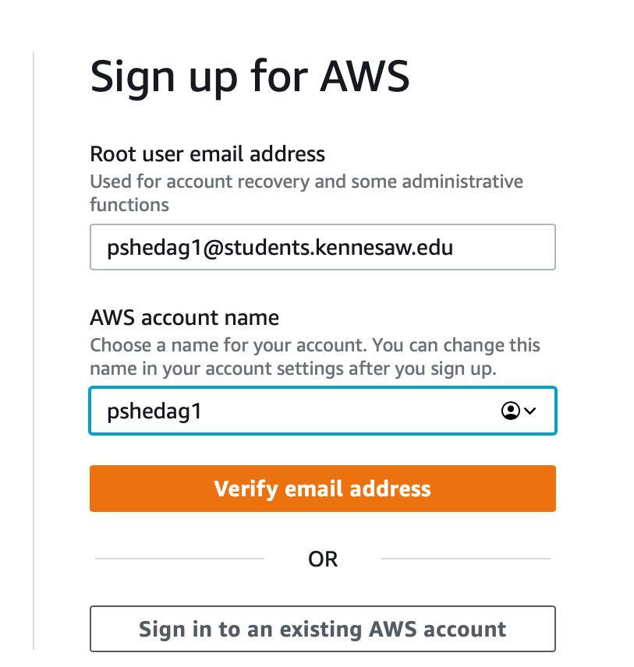
Go to https://aws.amazon.com/
Click on Sign in to the Console
If you do not have an account, click on Create an AWS Account

Slide 3
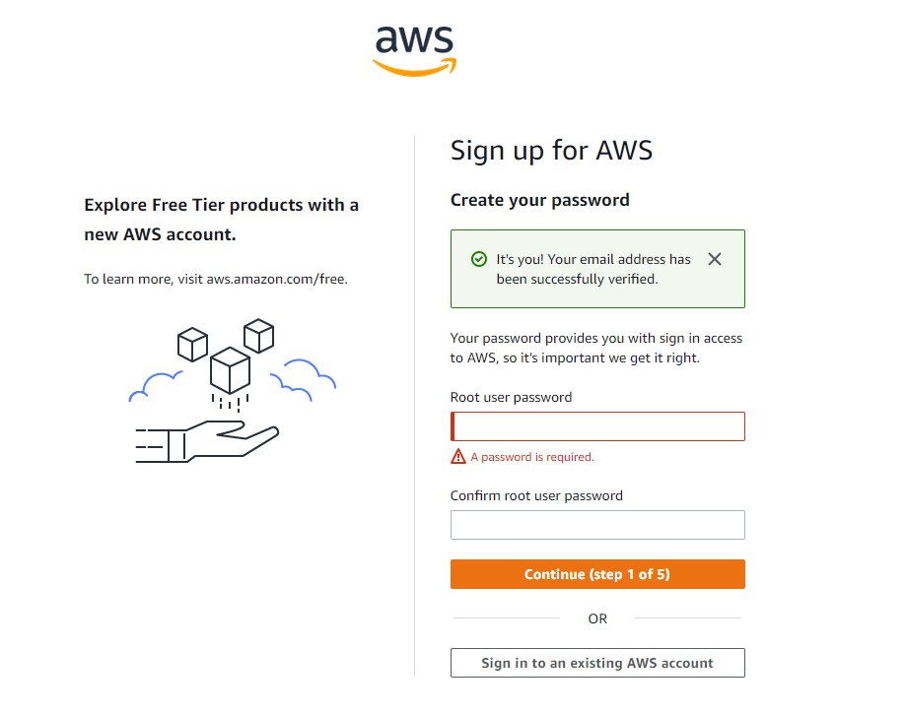
Verify your email then create a new password
Then continue with the steps

Slide 4
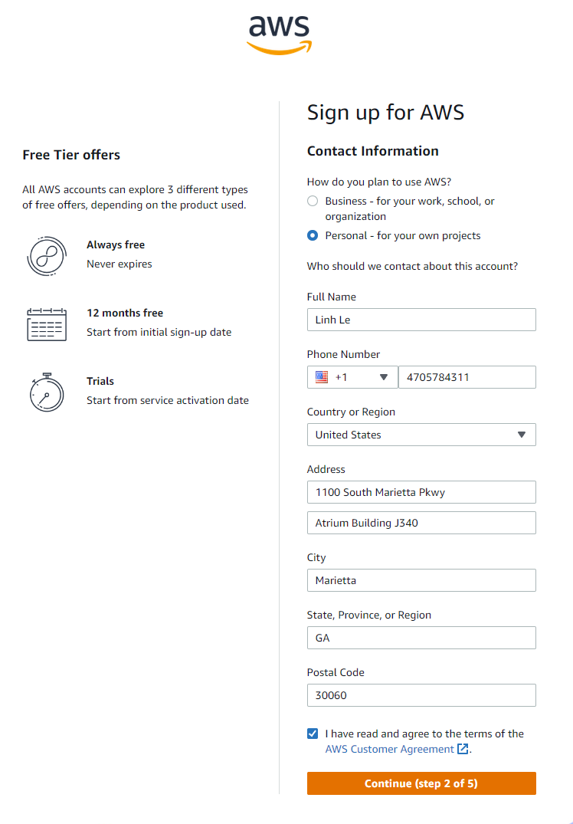
Fill more detailed information and click Continue

Slide 5
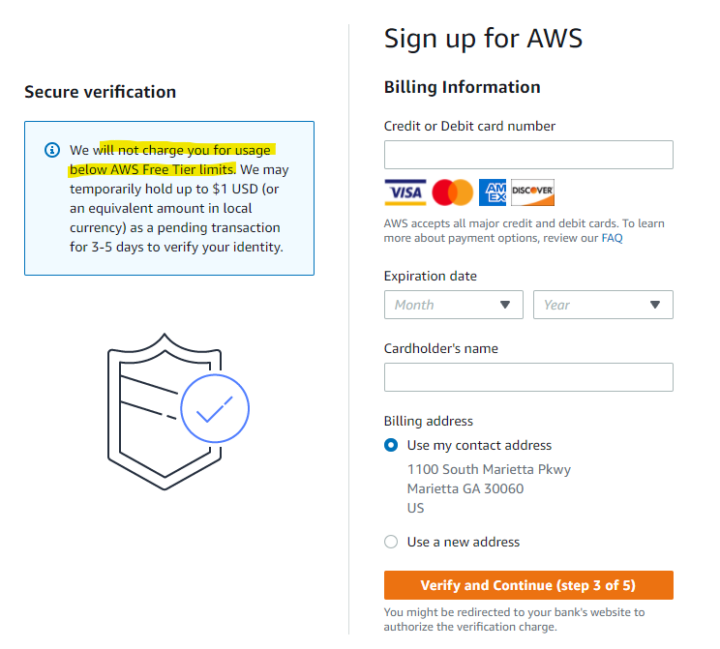
Enter your billing information. Note that you will not be charge any amount since the free services are enough for this course.

Slide 6
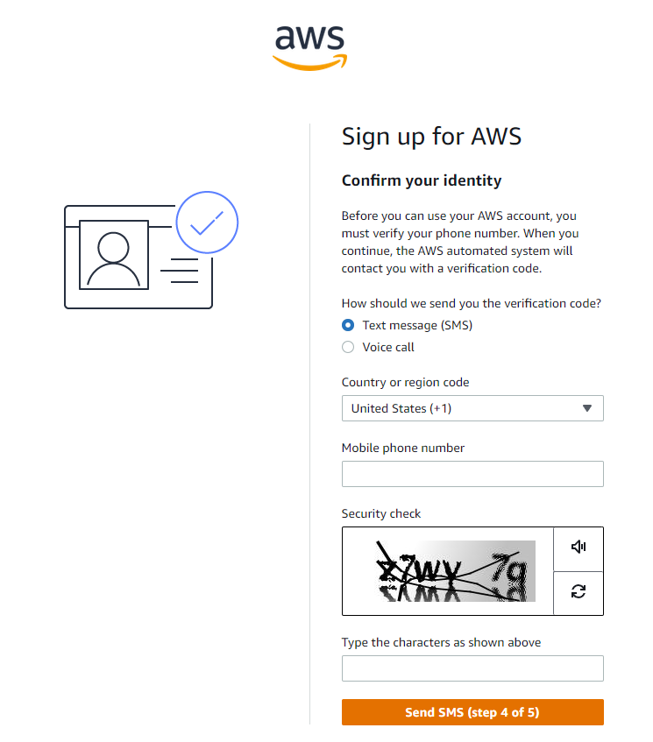
Verify your phone number

Slide 7
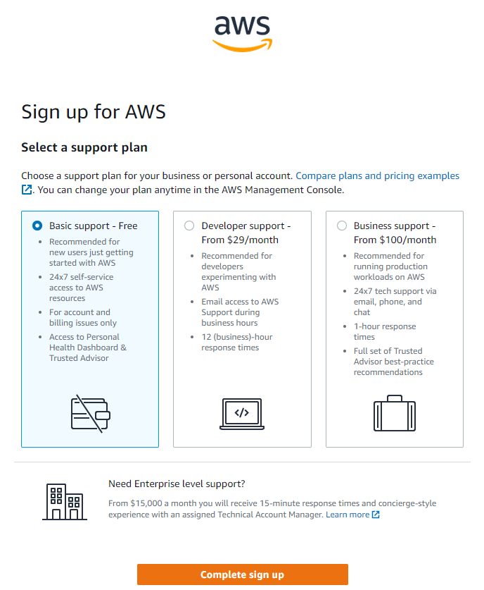
Choose the free tier

Slide 8
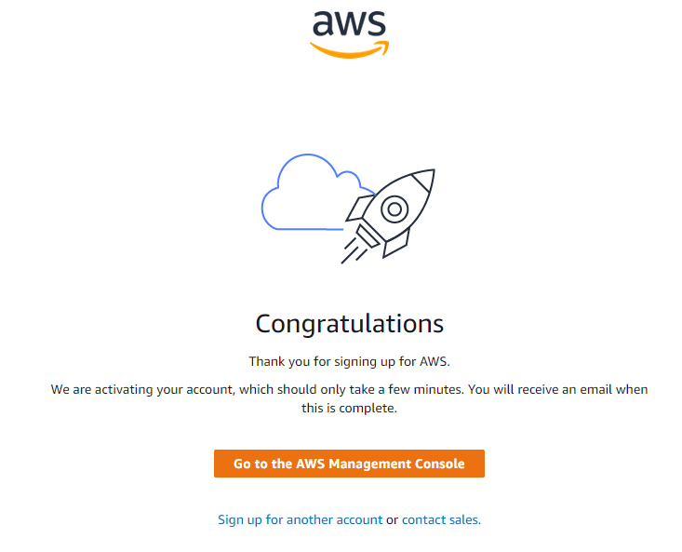
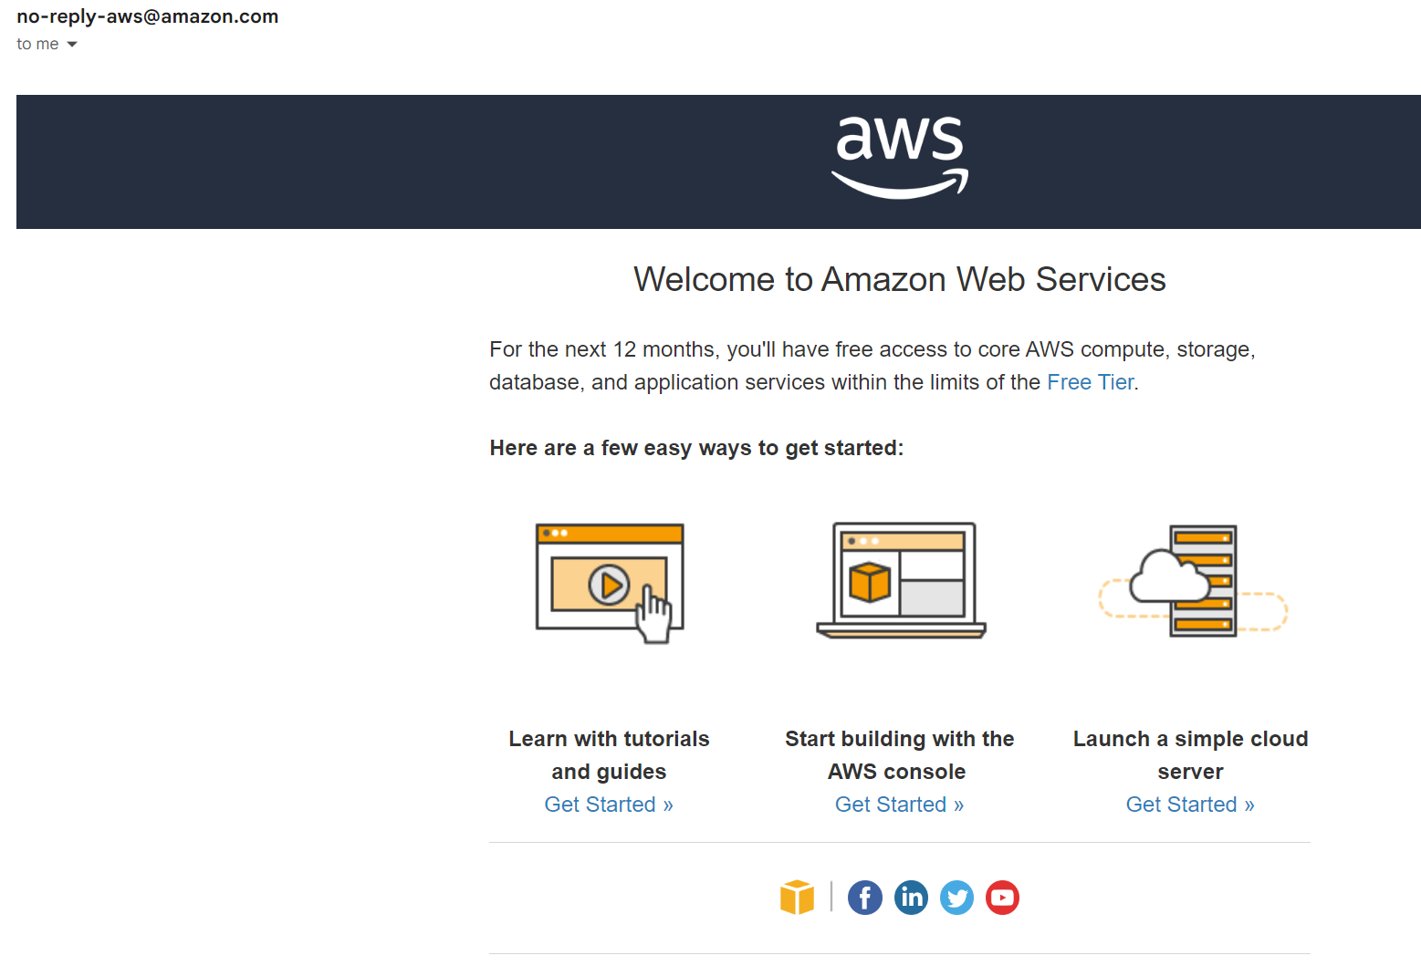
You will be redirected to this page. Wait for the activation email to come, then you should be able to sign in to your account.

Slide 9
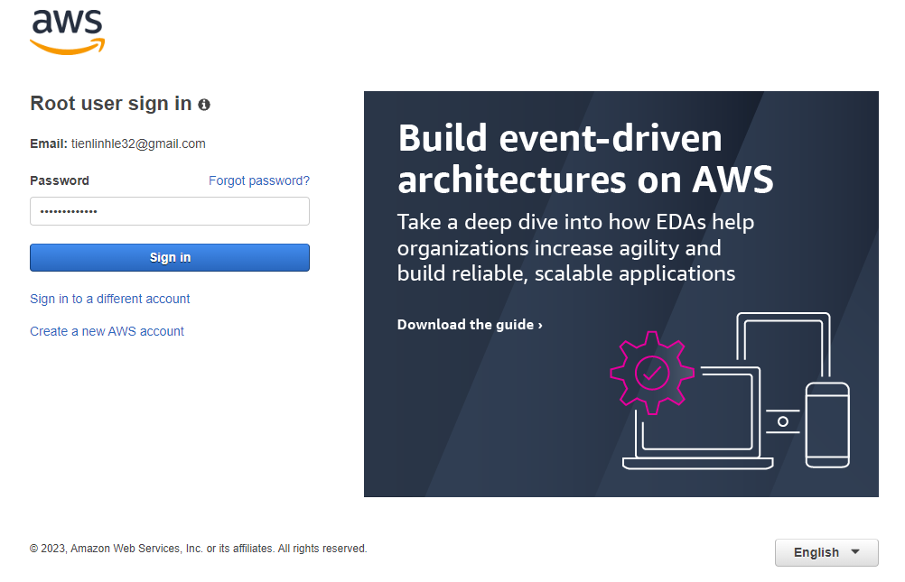
Return to https://aws.amazon.com/
Click Sign In to the Console
Select Root user and enter your email address (as well as captcha and password in the next page).

Slide 10
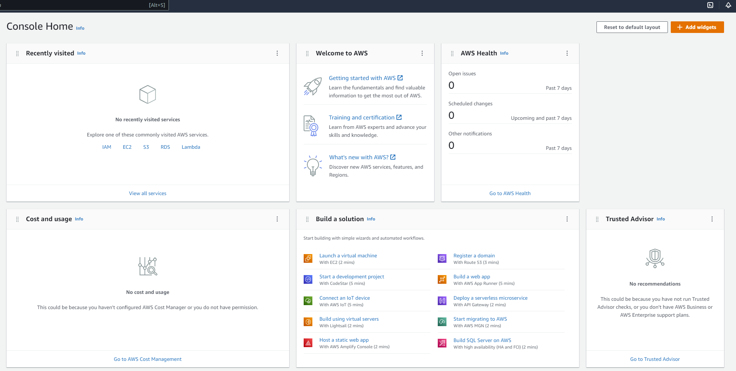
You will be redirected to AWS Management Console
Please follow this tutorial to set up your SageMaker environment https://aws.amazon.com/getting-started/hands-on/build-train-deploy-machine-learning-model-sagemaker/
Important: please follow the Clean up step carefully to avoid unwanted charges to your account.
We will discuss any new codes and UI later. For now, just need to copy and run the tutorial codes.
We will discuss modeling in SageMaker from the next module

